Slide 1





Welcome
CAM VIBE
Presented by BEST INOVATIVE
TECH(BIT)

Slide 2


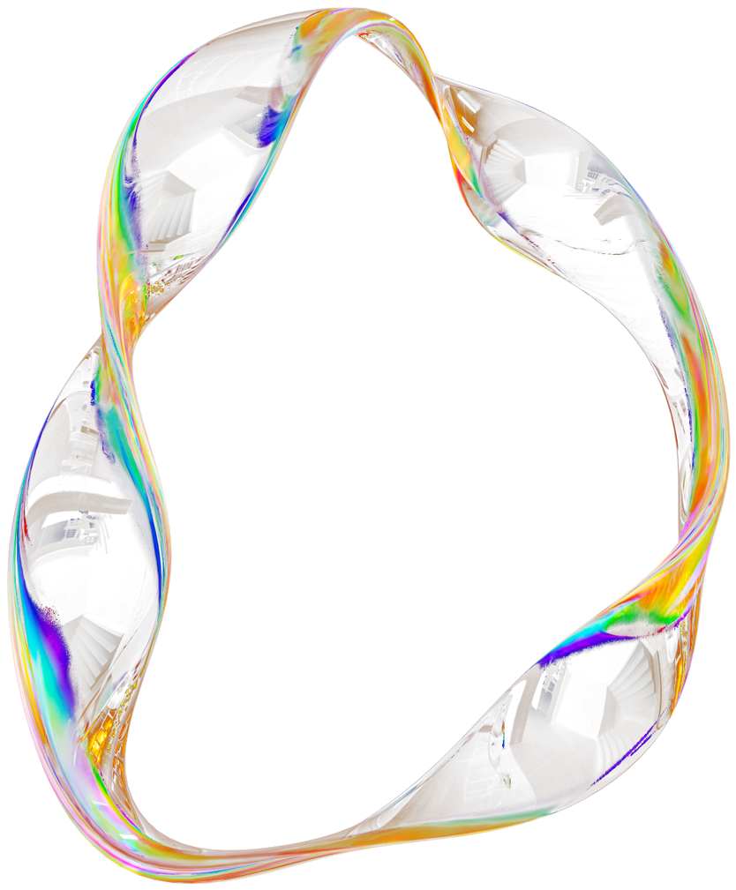
TODAY'S AGENDA
1
Introduction
2
Problem Statement
3
Our Innovative Solutions
4
Discover Our Services
5
Size of Market

Slide 3
INTRODUCTION
CamVibe is an AI-powered platform that helps Cameroonian artists create songs quickly. It generates melodies, lyrics, and full song ideas, turning inspiration into high-quality music in minutes while supporting local talent with faster and easier music creation.

Slide 4

Studio session are expensive
Recording with a label is costly, making it hard for upcoming artists
Explotation of Artist rights
Some producers, exploit artists like by controlling their work and limiting royalties.
PROBLEM STATEMENT
The Music industry is broken?
Upcoming artists lack access to production tools
Many artist lack acess to quality musical instruments

Slide 5


OUR INNOVATIVE SOLUTIONS
Ai Powered Music Studio
Distrubution and streaming
Mentorship and Sponsorship
Artists can join programs to receive mentorship from senior musicians and producers.
Experienced professionals may also sponsor promising newcomers.
This system helps develop young talent and strengthens the music industry.
Offers features that help leverage artificial intelligence to help users create produce and edit their music.
Help artist get their music to various online stores and services, making it accessible to listeners worldwide.

Slide 6
SIZE OF MARKET
Music in Cameroon remains underdeveloped due to limited resources and a small audience.
Only about 7 million youths actively engage with local music, far below the ideal market size.
To grow, the app must include artists, producers, and users from Cameroon, Nigeria, and other countries.
Cross-country collaboration will help strengthen the music ecosystem.
Revenue will come from Google traffic and monthly subscriptions for artists and producers.
Serviceable Obtainable Market: 480 K
Serviceable Addressable Market: 9.6 M
Total Addressable Market: 32 M

Slide 7
DIRECT COMPETITOR
APPLICATIONS SIMILAR TO CAM VIBE
Cameroon's music scene is thriving, with various streaming platforms competing for dominance. Here are some key players:
Local Streaming Platforms:
- Muzikol.
- Njoka TV.
International Streaming Platforms:
- Spotify.
- Apple Music.
- Boomplay.
Music Production Companies.
Music Management and Promotions.
Some examples of AI-powered music and lyrics generation software include:
1. Amper Music.
2. AIVA (Artificial Intelligence Virtual Artist)
3. Google's Magenta Studio.
4. Jukedeck.
5. OpenAI's Jukebox.
6. Lydia.

Slide 8
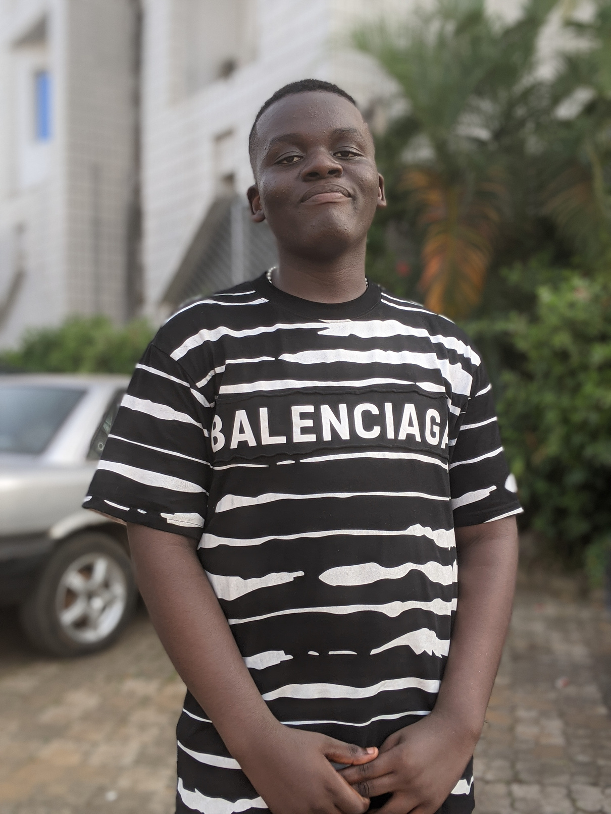
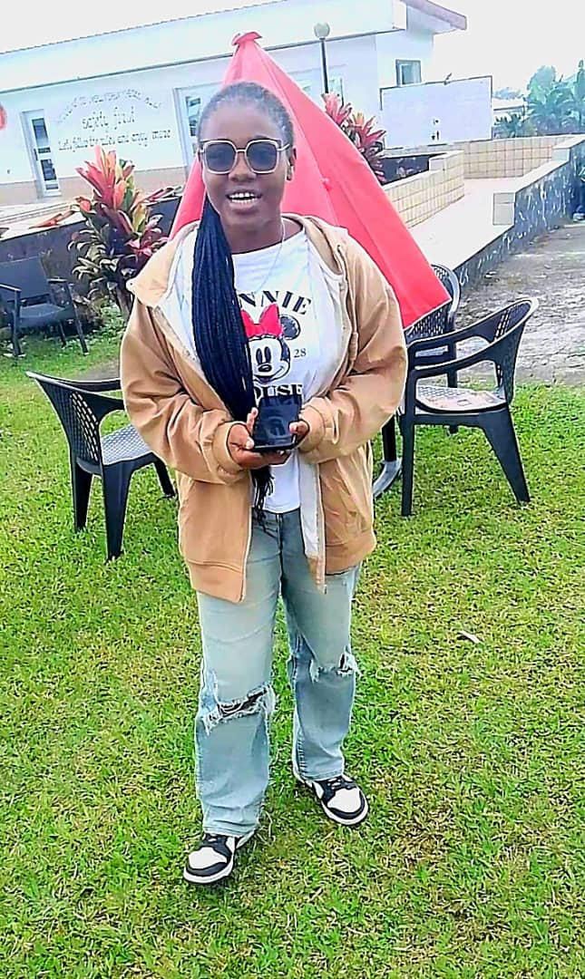


MEET THE TEAM
MATUTE MOLUA FRITZ
M. T. M-ANGE PRINCESS
AKO JUNIOR N.
S. MATHIAS MAHLA
Group Head
Project Advicer
Backend Developer
The front-end Dev.

Slide 9
THANK YOU
for your time and attention
Present by BIT TEAM

